Slide 1

COSI 104a Introduction to machine learning
Chapter 12 – Cluster analysis
 | Instructor: Dr. Hongfu Liu Email: hongfuliu@brandeis.edu
Main source: https://www-users.cs.umn.edu/~kumar001/dmbook/index.php

Slide 2
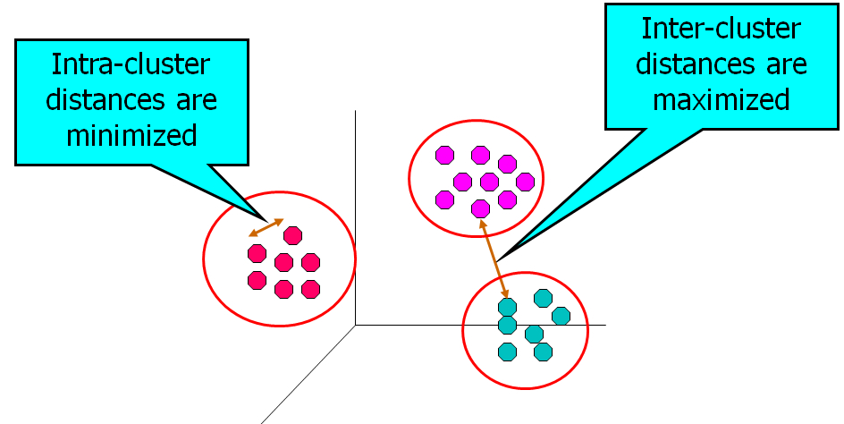


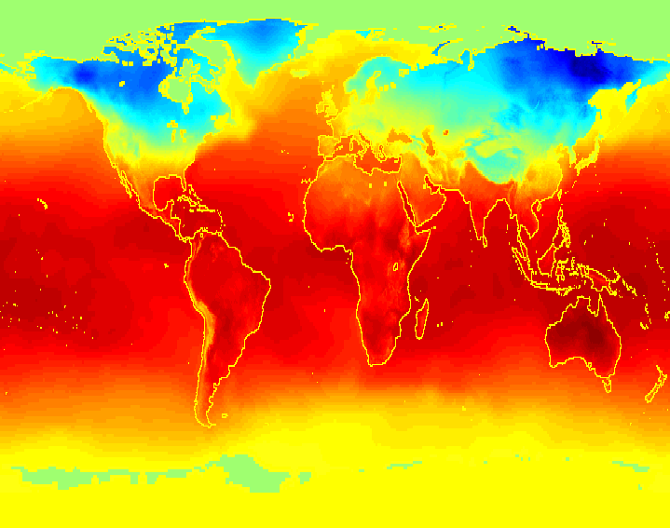

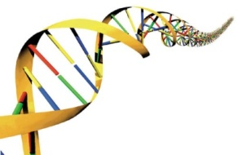
Cluster Analysis
Cluster analysis aims to find groups of objects such that the objects in a group will be similar (or related) to one another and different from (or unrelated to) the objects in other groups

Slide 3
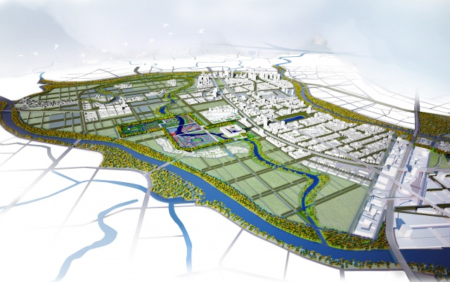


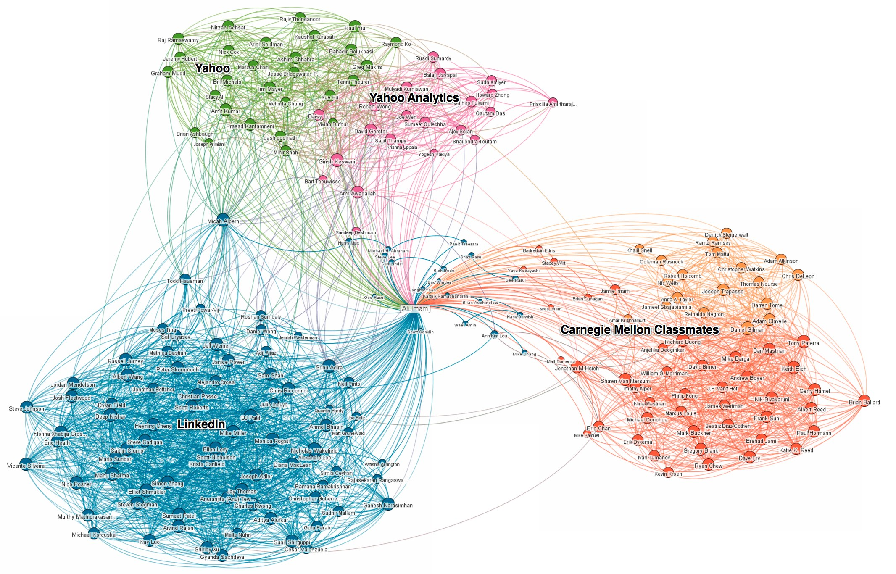
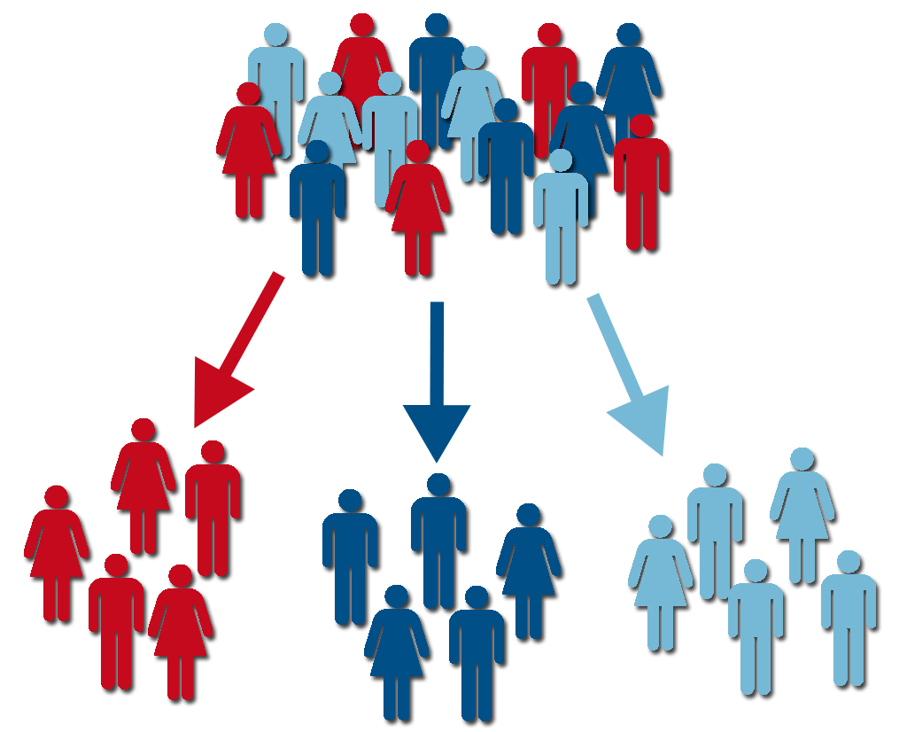
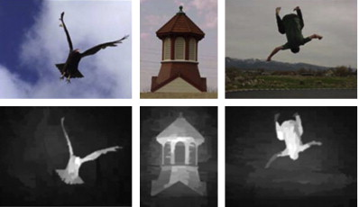
Applications of Cluster Analysis
Understanding
Custom profiling for targeted marketing
Group related documents for browsing
Group genes and proteins that have similar functionality
Group stocks with similar price fluctuations
Summarization
Reduce the size of large data sets
City Planning
Superpixel
Bigdata Visualization
Recommendation System
Customer Segmentation
Saliency Detection

Slide 4
What is not Cluster Analysis?
Simple segmentation
Dividing students into different registration groups alphabetically, by last name
Results of a query (SQL)
Groupings are a result of an external specification
Clustering is a grouping of objects based on the data
Supervised classification
Have class label information
Association Analysis
Local vs. global connections

Slide 5
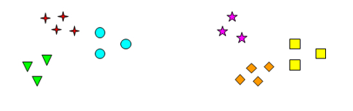
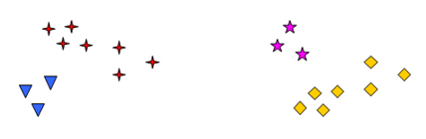
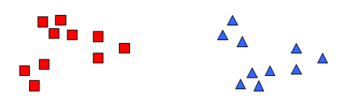
Cluster vs Clustering
Cluster
A group of similar instances
Clustering or Partition or Segmentation
A clustering is a set of clusters
A clustering has several clusters & Notion of a Cluster can be Ambiguous
One possible partition with 6 clusters
One possible partition with 4 clusters
One possible partition with 2 clusters

Slide 6
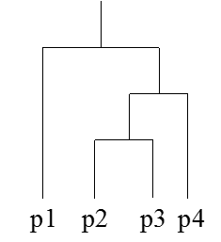
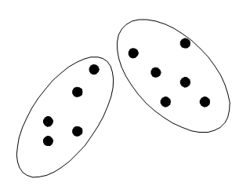
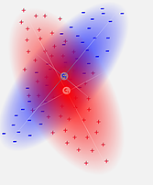
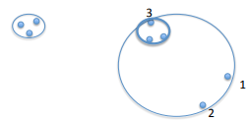
Types of Clustering
Partitional clustering vs hierarchical clustering
A division of data objects into non-overlapping subsets (clusters) such that each data object is in exactly one subset
A set of nested clusters organized as a hierarchical tree
Hard (Crisp) vs soft (Fuzzy)
A point must belong to only one cluster
A point belongs to every cluster with probabilities
Exclusive versus non-exclusive
A point belongs to one, multiple or none cluster
Partial vs complete
Key subgraph extraction
Partitional clustering vs hierarchical clustering
Fuzzy clustering
Non-exclusive clustering

Slide 7
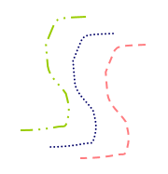

Types of Cluster
Well-separated clusters
A cluster is a set of points such that any point in a cluster is closer (or more similar) to every other point in the cluster than to any point not in the cluster.
Center-based clusters
A cluster is a set of objects such that an object in a cluster is closer (more similar) to the “center” of a cluster, than to the center of any other cluster
The center of a cluster is often a centroid, the average of all the points in the cluster, or a medoid, the most “representative” point of a cluster
Property or Conceptual
Contiguous clusters
A cluster is a set of points such that a point in a cluster is closer (or more similar) to one or more other points in the cluster than to any point not in the cluster.
Density-based clusters
A cluster is a dense region of points, which is separated by low-density regions, from other regions of high density.
Used when the clusters are irregular or intertwined, and when noise and outliers are present.

Slide 8


